Slide 1


A REVOLUTIONARY APPROACH TO HEALTH ANALYTICS
CorLytica AI – Predictive Health Analytics
Empowering early detection through data-driven insights

Slide 2



Team Details
Team Name-King Of The New Era
Team Members
Akshat Tiwari
Sandip Ghorai
Deepak Kumar
Abhimanyu Yadav

Slide 3
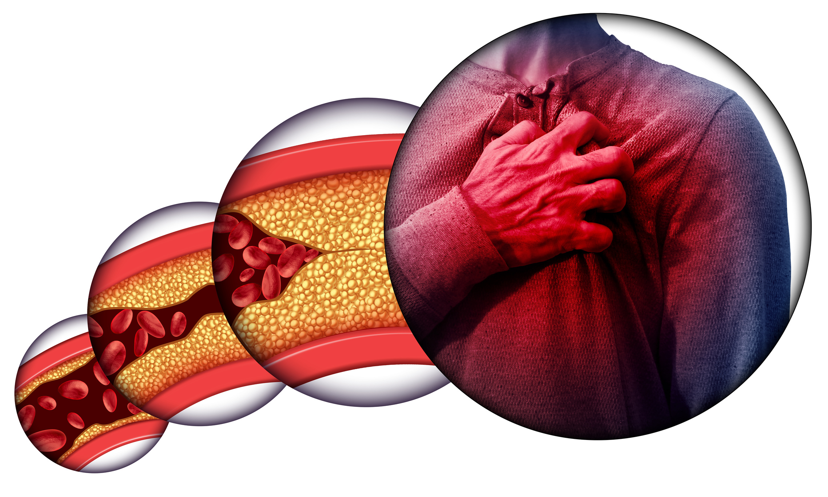

problems and needs
Lifestyle diseases (heart disease, diabetes) affect millions each year
Diagnosis often happens after major damage
Rural clinics lack quick risk-screening tools
Existing apps give generic advice or black-box scores
Need: Accurate, transparent, easy-to-use platform for early risk prediction

Slide 4

Proposed Solution: Corlytica AI
A seamless approach for preventive healthcare
Users input key health metrics / upload simple report
AI predicts risk, explains key factors & gives safe wellness tips
Flow:
Patient Data → Risk Score → Explainability → precaution and meaasurements

Slide 5
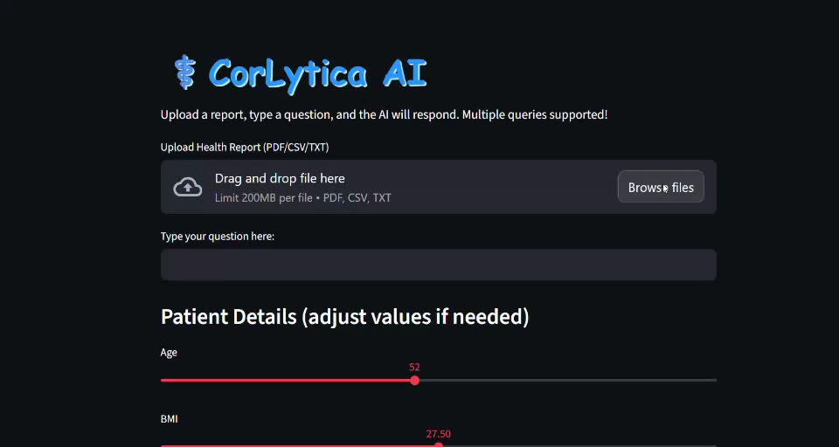

Slide 6

Tech Stack (MVP):
Python, Scikit-learn / XGBoost
FastAPI (model API)
Streamlit + Plotly (dashboard & charts)
Streamlit Cloud / Render (deployment)
Architecture Roadmap:
Dataset→Model Training→FastAPI → Streamlit UI → Cloud Hosting
Tech Stack Overview
Explore our architecture and tools for Corlytica AI.

Slide 7
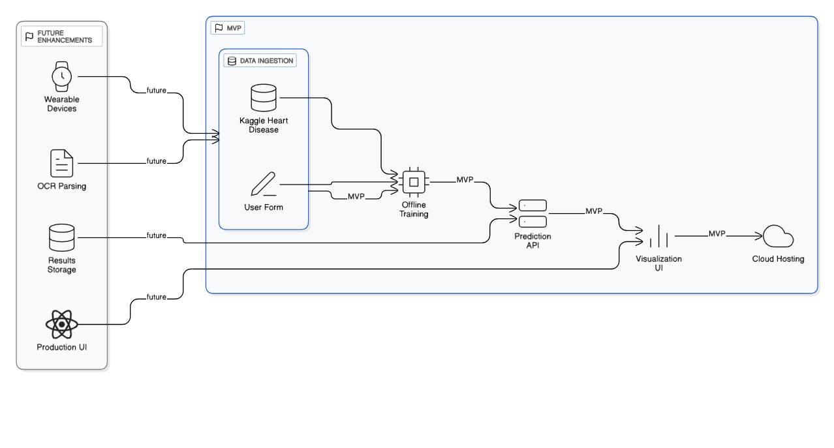

Slide 8
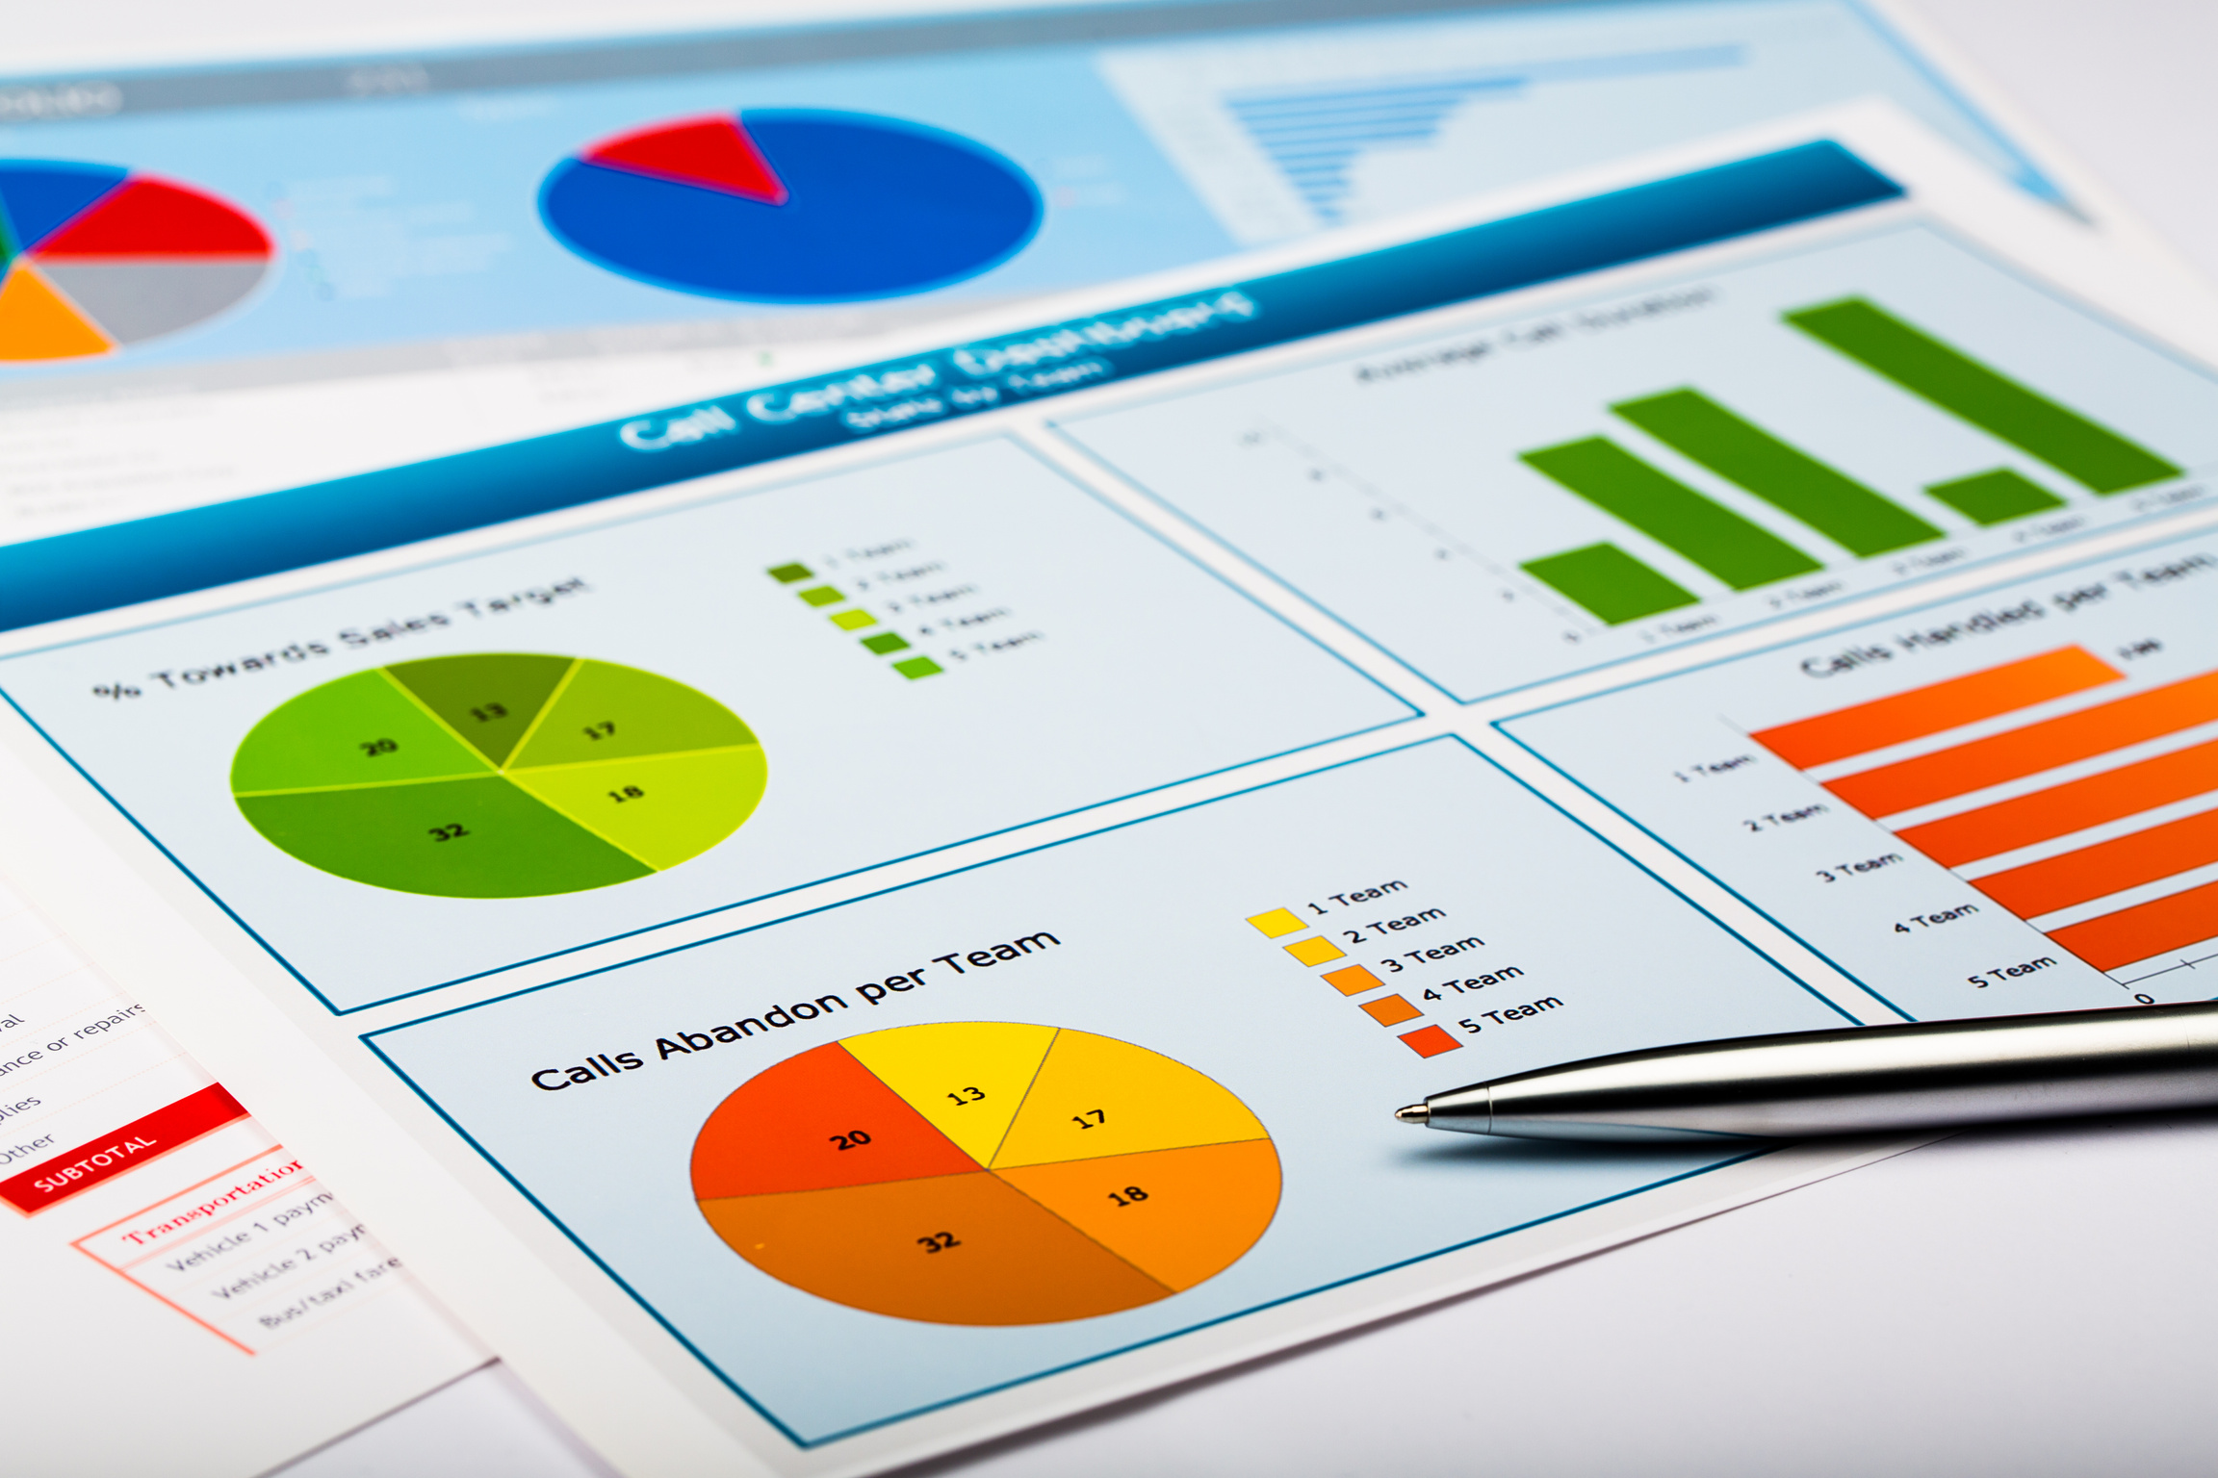
Challenges & Feasibility
Navigating obstacles for successful implementation
Challenges:
Text Extraction and Data Cleaning
Balancing speed vs accuracy
Explaining results in plain language
Feasibility:
Lightweight model → runs in ms
Streamlit Cloud = fast hosting
Clear roadmap for scale & privacy compliance

Slide 9

"Transforming healthcare through technology is not just a vision, but a commitment to ensuring accessible and efficient solutions that enhance early detection and promote overall wellness for everyone."
-CorLytica AI Team

